Slide 1

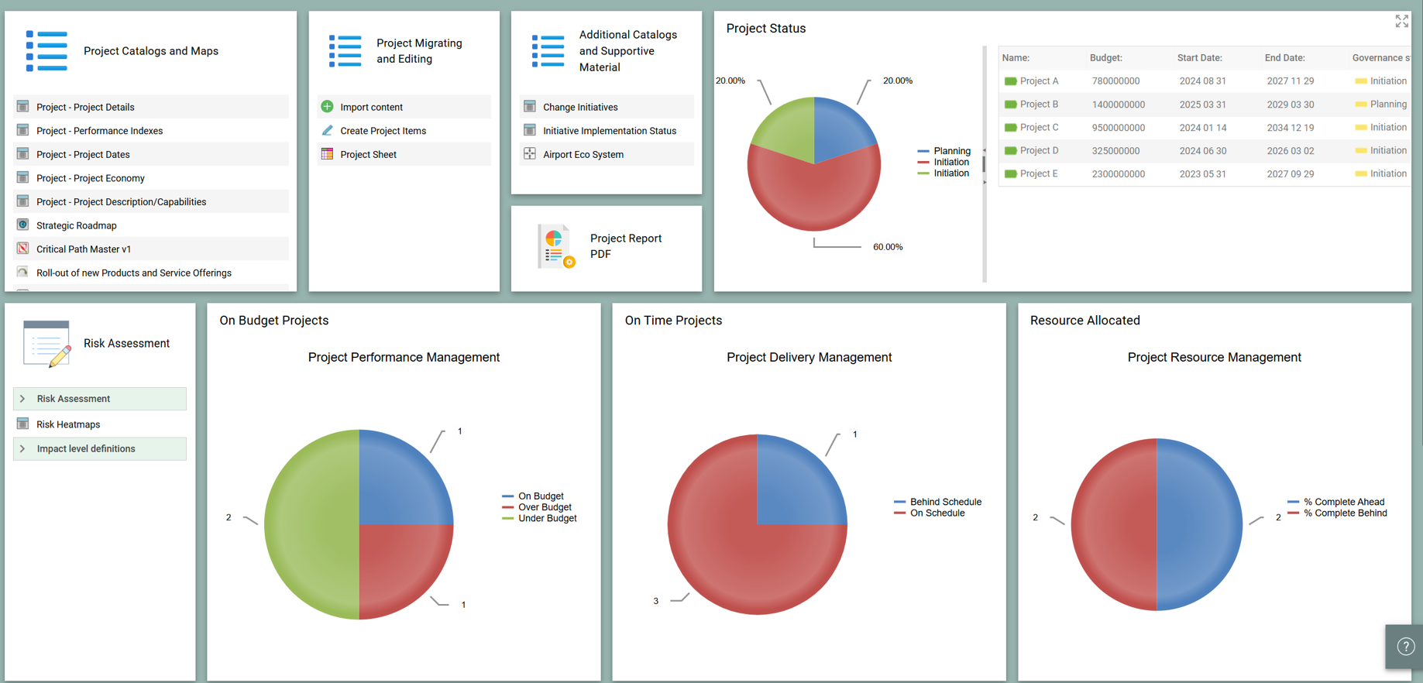


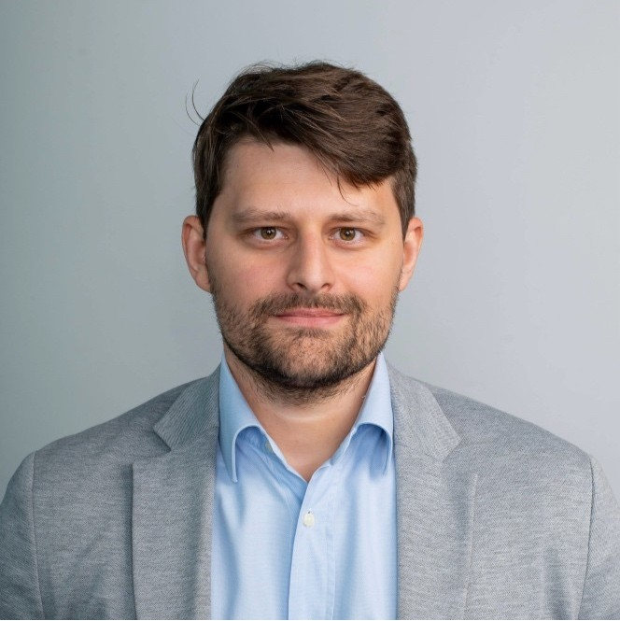

QualiWare
Partner Spotlight Webinar Series:
Brenda Cowie
SVP Americas
QualiWare
Kevin O’Rourke
President
CloseReach
Kirill Kasyanenko
Product Management
CloseReach
Anthony Bianco
SR Business Analyst
CloseReach
Notes:
NARRATION:
"Welcome. This is QualiWare's 2026 business update — a ten-minute overview of where we are as a company, what we've built, and where we're going. We've structured this around the metrics and milestones that matter most to this research team."

Slide 2
Today’s Agenda:
Qualiware
CloseReach
Qualiware: Who we are
CloseReach Overview
Qualiware: Metrics that Matter/Market Credibility
CloseReach PPM solution
CloseReach Partnership
Live DEMO
Why PPM Matters Now
Project & Change Request Tracker- Customer Use Case
Q&A
© QualiWare ApS
3

Slide 3



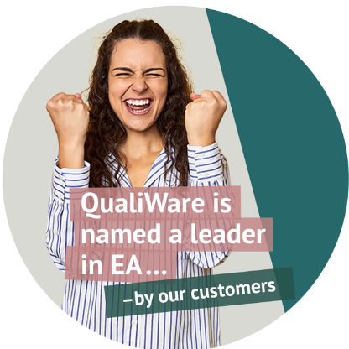
Denmark (HQ)
USA
UK
United Arab Emirates
Australia
Brazil
France
Ukraine
Korea
Canada
Sweden
Vietnam
South Africa
Energi & Utilities
Process & Compliance Management
Data & Risk management
Application Portfolio Management (APM)
Digitalization
Digital Twin (DTO)
Government
Defence: NATO Architecture Framework
Resource optimization
Compliance
Data Architecture
Finance
DORA compliance desktop
IT risk management
Digitalization
Risk & Compliance management
Manufacturing
Digital Twin (DTO)
Process Optimization
Seamless integration with Power BI
AR App: Instant knowledge and guidance in the field
Who we are: QualiWare - Experienced Market Leaders you can trust!
QualiWare is a leading Enterprise Architecture, Compliance Management and Business Process Management solution, used in Digital Transformation initiatives that seamlessly integrates with specialized tools for a comprehensive, global, and cross-vertical management experience laser focused on delivering business value & impact!
QualiWare is an established market & thought leader with 35 years of expertise in Enterprise Architecture, Business Process, Compliance and Digital Transformation serving a global client base with a modern approach.
Headquartered in Copenhagen Denmark with offices in New York, Toronto, London, Stockholm, Brisbane, Johannesburg, Sao Paulo and a robust partner channel to cover any region.
1000+ customers around the globe trust their business to QualiWare!
“QualiWare is the brain of our company”
Oliver Loukota - Enterprise Architect , Q beyond
Notes:
A bit about us: Qualiware is an established firm , rated consistently as a leader & visionary by Gartner, Infotech ( Forrester) Spark DTO etc……
80+ employees
Note: ……Highly regarded in the industry the company was founded by an academic friend group way back when…although we have been around for awhile, we have a very modern, outcome driven approach to enterprise architecture and in fact Gartner thinks our digital twin and AI is the best in the category. For many years now, we are consistently rated as a leader by leading analyst firms as well as by our customers!
A long established leader in the market, Qualiware has a global reach through it’s own regional offices and partner channel
Offices:
Copenhagen, Denmark
New York, USA
Toronto, Canada
Johannesburg, South Africa
London, UK
Stockholm,Sweden
Partners:
USA
Canada
Sweden
Norway
France
Germany
UAE
Saudi Arabia
Vietnam
Australia
UK
France
South Korea
As expected, our platform brings with it all the expected standards and ratings to ensure we provide business integrity to our customers.

Slide 4
QualiWare Platform — At a Glance
1000+
35
80+
5
Active
Global Partner
Network
Customers
Years
Dedicated Experts
Certifications
EA · GRC · BPM
Founded 1991
Global team
ISO · SOC 2 · UN
Active worldwide
SaaS
ISO 27001
ISO 9001
SOC 2
UN Global Compact
ISO 223001
Deployment
Info Security
Quality
Compliance
Signatory
Business Continuity
© QualiWare ApS
2
Notes:
NARRATION:
"QualiWare was founded in 1991 — 35 years ago. We now serve over 1,000 customers across enterprise architecture, GRC, and business process management. 22 of those deployments meet Gartner's own five-building-block criteria for a Digital Twin of an Organisation., an up and coming category now seeing traction in the marketplace.
Our longest customer term is 27 years and our average customer term is 15+ years, unheard of with any other vendor in this category. It is also an important call –out that all of these capabilities come from a single, integrated platform and vendor— not a stack of tools assembled through acquisitions."

Slide 5
Metrics that Matter: Business Outcomes — Proven, Measured, Repeatable!
25%+
24 hrs
18
90%
$15M
50%+
Operational Efficiency
Regulatory Speed
Certification Management
Audit Performance
IT Cost Savings
Cost Rationalisation
Cost reduction — global electronics manufacturer, 20+ sites
GDPR compliance — all systems already mapped in QualiWare
Simultaneous certifications managed in a single QualiWare repository — global manufacturing client
Reduction in audit findings — across 200+ audit days
Saved per year by eliminating redundant and sub-optimal IT support in operations
ISO implementation cut via cross-institution mapping, national defence
© QualiWare ApS
6
Notes:
“Here we see some examples of Six outcomes from six different organisations.
A global manufacturer cut operational costs by more than a quarter.
A large pension fund achieved GDPR compliance in under a day. Saving millions in project costs.
A manufacturing client manages 18 simultaneous certifications from a single QualiWare repository.
A second manufacturing client had Audit findings drop by 90% across more than 200 audit days.
One organization in the energy sector saves 15 million dollars per year by eliminating redundant IT support.
And finally, a national defence organisation cut implementation costs in half when rolling out new standards and regulations across Army, Navy and Airforce.
The pattern is consistent: when process, capability, data, and systems are visible in one place, organisations move faster and spend less."

Slide 6

Why PPM Matters Now : Focus on & Measure What Matters!
What the Experts Say…….
McKinsey & Company
Gartner
“Corporations that consistently refresh their business mix outperform their peers in TSR by 3.5 percent over the long term, honing their portfolios to develop, acquire, and divest businesses to realize their enterprise strategy”
Implication:
Significant Business impact on Total Shareholders Return, focus investment on the most strategic capabilities.
Active portfolio management: Five practical insights | McKinsey
“The expansion of digital responsibility and capability beyond IT requires new approaches to prioritize and orchestrate portfolio investments to achieve desired business outcomes.”
Implication:
a shift in skill sets is needed to provide effective decision support across investment planning and strategy execution.
Top Trends for Program and Portfolio Management Leaders for 2025
…..
Project Management Institute
“Here's a number that should keep every executive awake at night: out of more than 22,000 projects studied across every sector, only about 0.5% delivered on budget, on time, and on the benefits they promised. One project in 200 to 250. ”
Implication:
PPM shifts organizations from disorganized use of resources to structured optimization
What 22,000 Projects Reveal About Success and Failure | The PMI Blog
Notes:
In today’s ever changing market, investment decisions, optimizing costs matters more than ever. I often advise folks and teams to focus on and measure what matters in their organizations. Take a look at your CIO’s calendar…if the bulk of their meetings don’t relate to what the bulk of your activity is, take a look at what you are focssing your efforts on.
Effective Project Portfolio Management (PPM) enables organizations to:
prioritize the right initiatives
align investments with strategic business objectives
optimize resource allocation
improve delivery outcomes.
Supported by QualiWare, organizations gain a centralized, real-time view of their entire project portfolio, allowing decision-makers to evaluate:
risks
dependencies
Costs
Benefits
and strategic alignment before committing resources.
By connecting projects to business capabilities, enterprise architecture, and strategic objectives, QualiWare helps organizations reduce redundant investments, improve governance, accelerate informed decision-making, and maximize the value delivered from every project!
Drive Business Priorities
Gain visibility into active and planned project investments.
Focus investment on strategic capabilities.
Prioritize investments based on alignment and impact.

Slide 7


Take Control of your Project Portfolio with QualiWare
July 8 2026
Delivering Digital Transformation Business Value
with Expert Consulting, Software & Training solutions

Slide 8
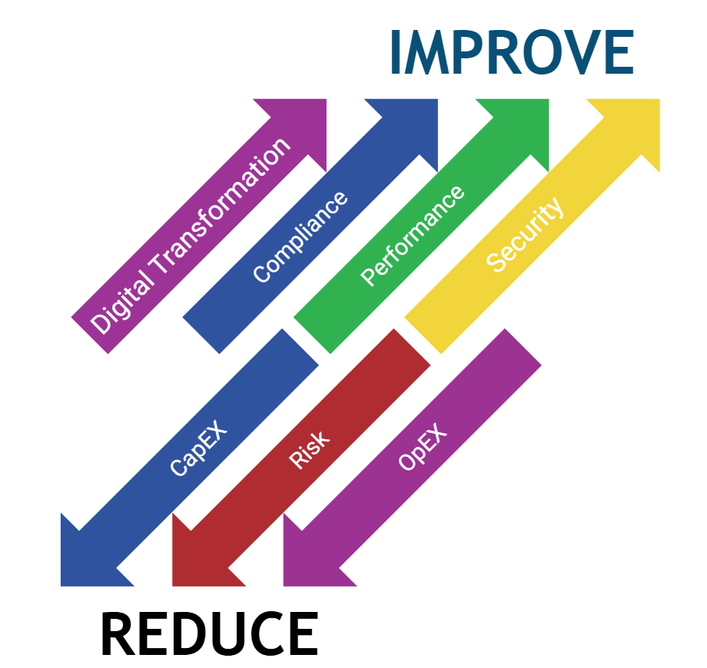


About CloseReach
Canadian corporation, Established in 2004. HQ in Ottawa, offices in Halifax and Toronto
Core expertise in Enterprise Architecture, Compliance Management, and Business Management Systems
QualiWare’s partner in Canada since 2009 with clients ranging in size from a team of 10 to 100,000 FTEs
Government of Canada EA Solutions provider since 2017 (over 30K QualiWare licenses)
make Enterprise Life easier

Slide 9
CloseReach = make Enterprise Life easier
Focus on and measure, what matters!
  Our expertise in Digital Transformation, Enterprise Architecture, Business Architecture & Management Systems coupled with our bespoke client approach ensures the focus is on high priority, relevant activity tied to your organization’s business goals.
Major client pain points we see today:
  Information silos
  Data relationships and application integration
  Lack of sophisticated operations management systems
  AI
Make Enterprise Life easier.
  20+ years of consulting expertise, software and services combine to establish strong foundations and deliver business value that support business decisions with integrity, to prioritize projects that drive efficiencies, innovation, agility and strategic alignment.

Slide 10
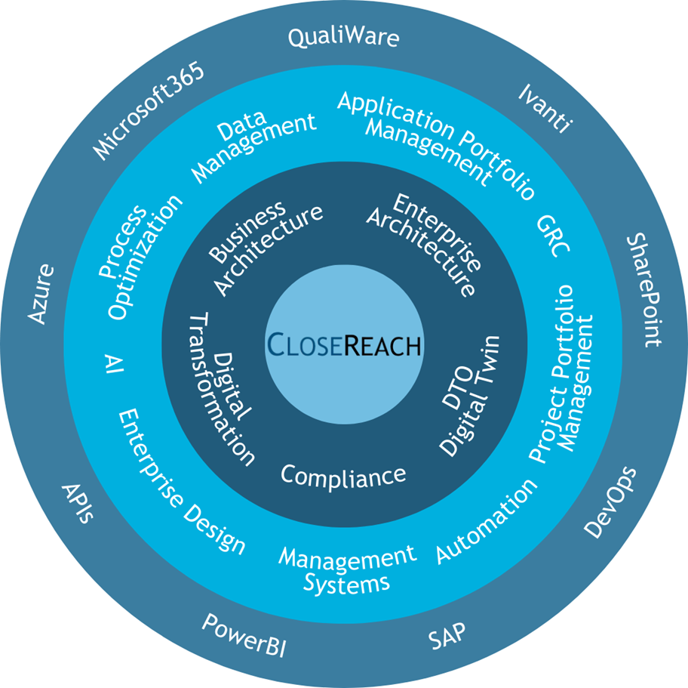
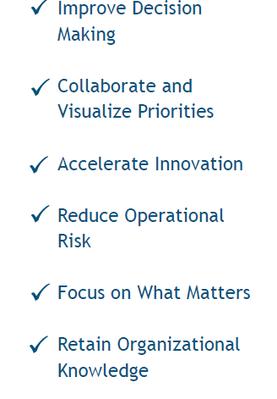
CloseReach = make Enterprise Life easier
make Enterprise Life easier

Slide 11

Project Portfolio Management Solution by CloseReach
make Enterprise Life easier

Slide 12
Project Portfolio Management Solution Highlights
Centralized repository for entire project portfolio
Designed for decision-makers, portfolio managers and individual project managers
Standardized governance and lifecycle management
Project risk register and mitigation
Configurable and integration-ready project catalogs
make Enterprise Life easier

Slide 13
Project & Change Management Tracker
Business Issues
  Customer was using a manual MS Access-based solution to manage over 500 projects. Current system and process was not sustainable given current workload and planned future growth
  Audit finding stated they needed a solution to provide defensible, data-driven decision making at scale
Other Pain Points
  Manual entry of status data
  Low visibility across the project lifecycle
  No effective way to track approvals, reviews and results
  No oversight on priority projects
Requirement
  New solution to manage projects
make Enterprise Life easier

Slide 14
Project & Change Management Tracker
Solution: QualiWare-based Management System
Low-cost, low code platform
Personalized dashboards for each role and user so they see what they need to see, when they want to see it
Automated governance workflow for projects to manage project details, track approvals, reviews and alerts
Integrated change request management and risk management to support the management of projects
CloseReach developed a Project & Change Management Tracker prototype in 3 months to verify business requirements followed by full scale development.
make Enterprise Life easier

Slide 15
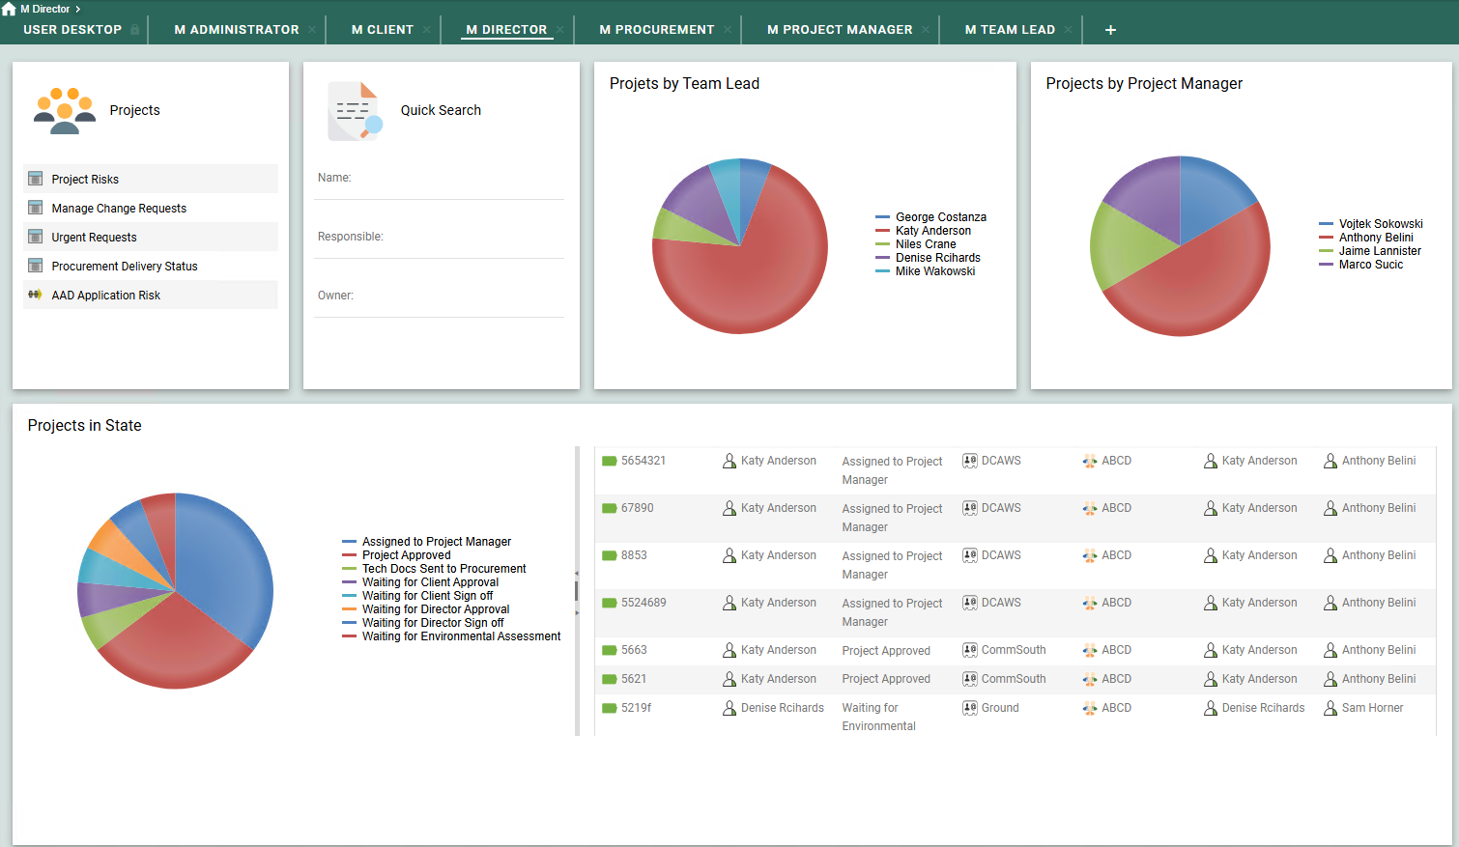
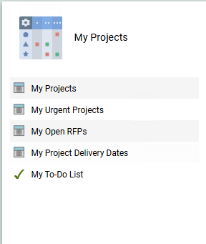
Project & Change Management Tracker
make Enterprise Life easier

Slide 16

Thank You!
QualiWare
Partner Spotlight Webinar Series:
Kevin O’Rourke
President
CloseReach
Kirill Kasyanenko
Product Management
CloseReach
Anthony Bianco
SR Business Analyst
CloseReach
Brenda Cowie
SVP Americas
Qualiware
Notes:
NARRATION:
"Welcome. This is QualiWare's 2026 business update — a ten-minute overview of where we are as a company, what we've built, and where we're going. We've structured this around the metrics and milestones that matter most to this research team."

